Slide 1
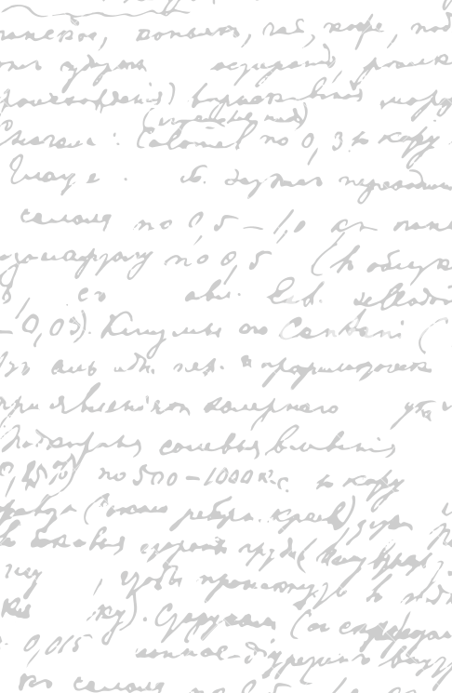

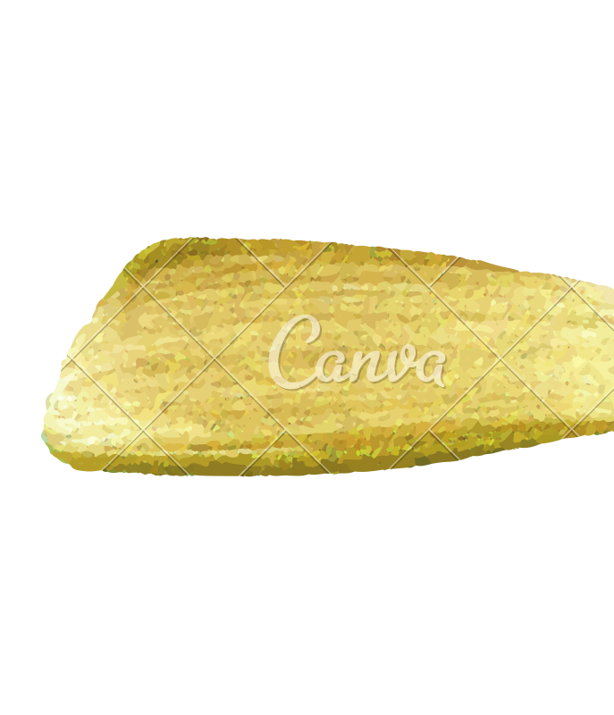

Ming Wu (Andrew) 2133861w
Laser Mate!
Project Supervisor Meeting 11
29 January 2021

Slide 2
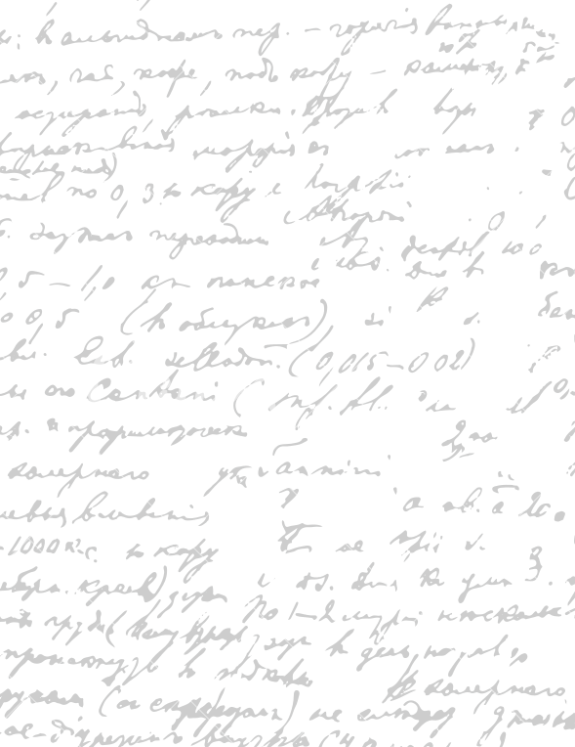



Start Recording

Slide 3
Main Topics
Evaluate dissertation parts
Evaluate digital prototype

Slide 4
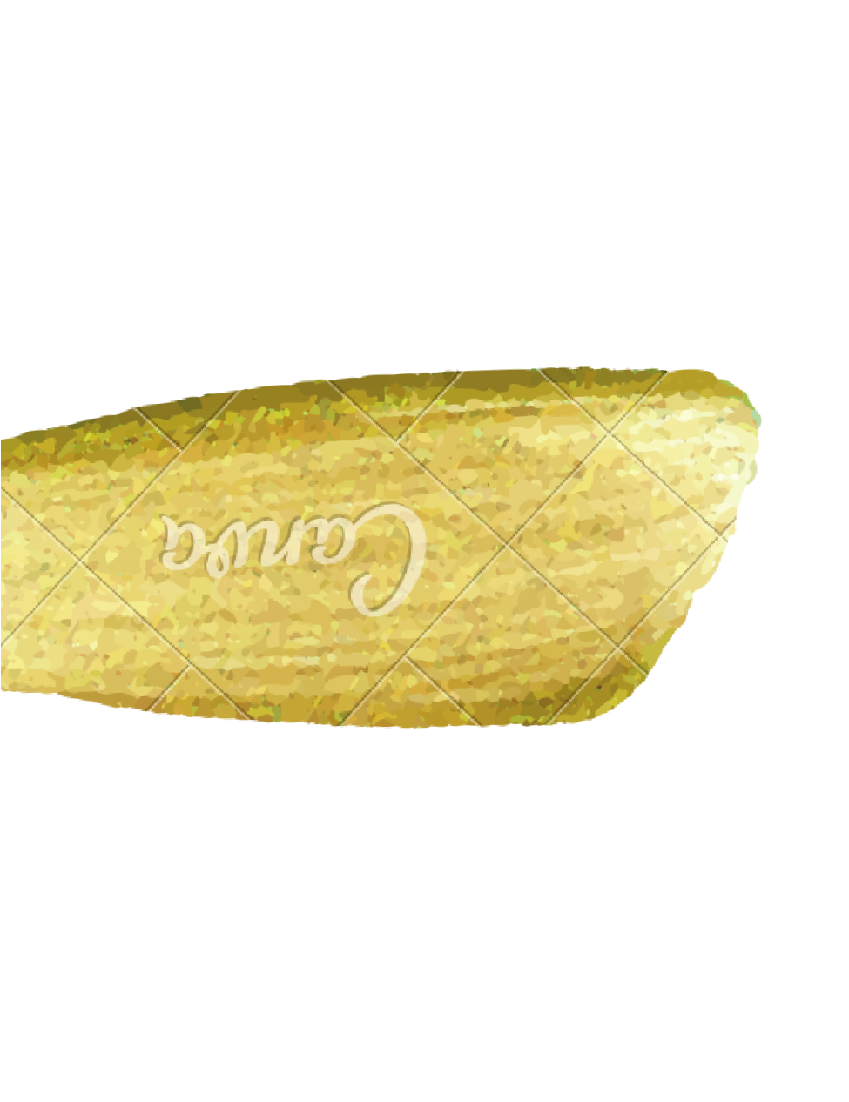
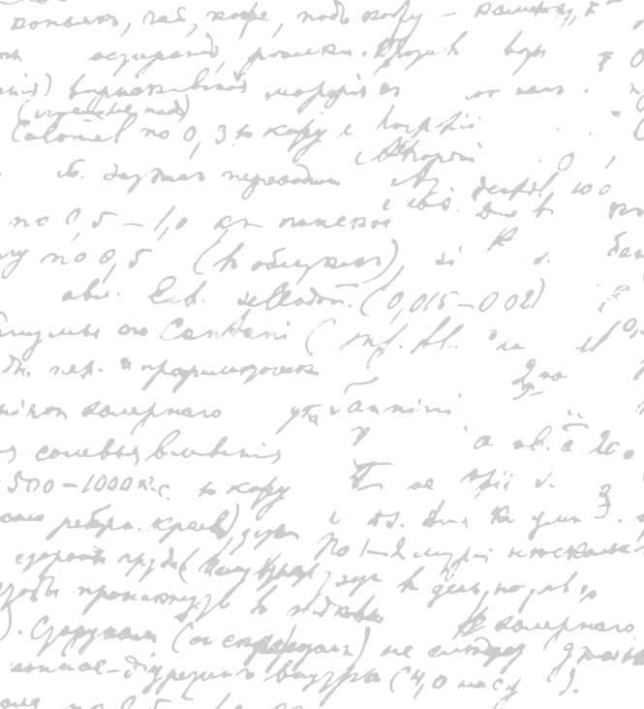

Evaluate Dissertation
Parts
User Stories & Acceptance Criteria
Design Principles
Outsourcing Strategies & Business Scaling & Optimization Metrics

Slide 5
2. Evaluate and Refine Current Digital Prototype
Restaurant Owner
Company Staff
Company CEO
Password staff login see owner site
Remove qr code
Don’t store bank details – law
Don’t think about this, think about this after the project – not important
For each software part,
- describe why it is a good design; suggest areas of improvement, consider alternative designs.
Colour Scheme/ Contrast
Font Size/ Style
Way of presentation (order of information display)
Word Choice/ image
Icon shape/ size
Spacing/ Proximity between words/images
Software process (how to navigate between pages)
Necessity (whether this part must be present)
What can be added and why
What can be deleted and why
What can be improved and how/ identify the solutions

Slide 6
Go through only the most important part of each section of the dissertation
describe what you write and why you write it
Determine whether this section is important to put in
What is missing in this section
What points to delete in this section
Possible writing template/ example work for reference
3. Refine dissertation

Slide 7
End

